Slide 1
SHORELINE FIRE
SURPLUS sale
SUBMIT SEALED BIDS Attention DC Matt Hochstein AT Station 61 ON OR BEFORE 4pm on Thursday September 18, 2025

Slide 2
Rules and instructions for bidders
Item preview will be available by appointment on Thursday September 18 between 10am and 4pm. Email ahansson@shorelinefire.com to schedule appointment
SUBMIT SEALED BIDS Attention DC Matt Hochstein to Station 61, (17525 Aurora Ave N Shoreline, WA 98133) ON OR BEFORE 4pm on Thursday September 18, 2025
Written bid must include bidder’s name, contact information, item # and description of item/items bidding on and bid price for each item
Bidders will be notified by 6pm on Thursday September 18, 2025
Item Pick Up will be Friday September 19, 2025 between 10am and Noon. (Alternate pick up dates can be scheduled for special circumstances)
All sales are final, cash paid in full at time of pick up, no warranties/as is condition and no deliveries.

Slide 3
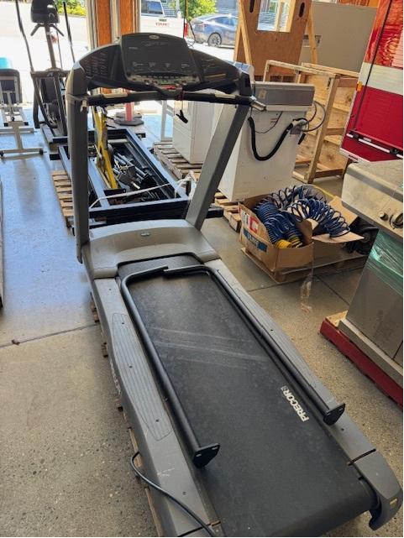
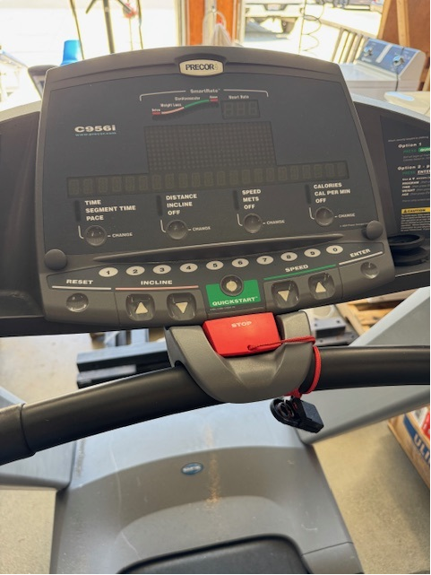
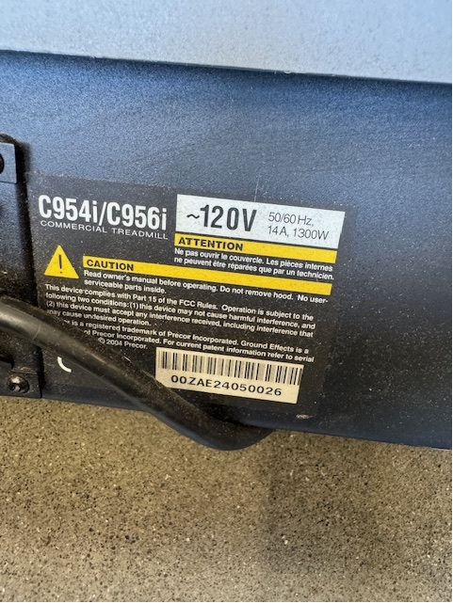
Item # 1
PRECOR C956i treadmill

Slide 4
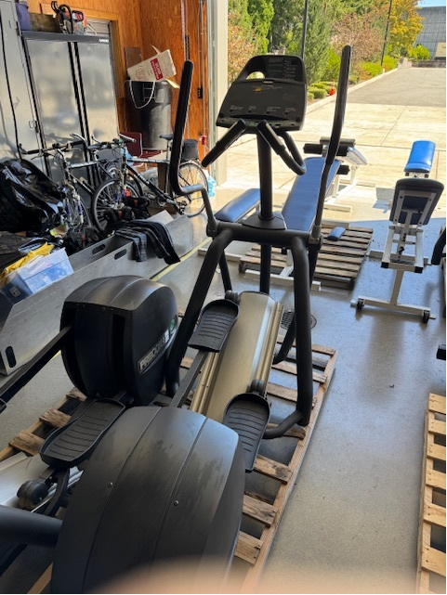
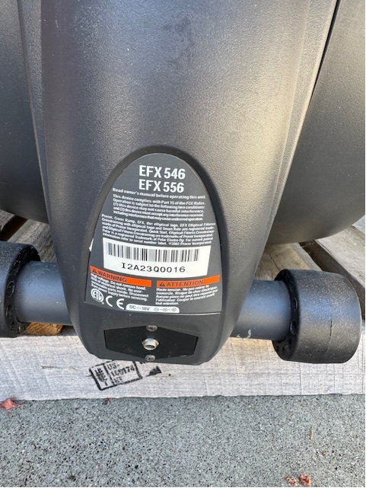
Item # 2 precor efx 556 (Serial # 016)

Slide 5
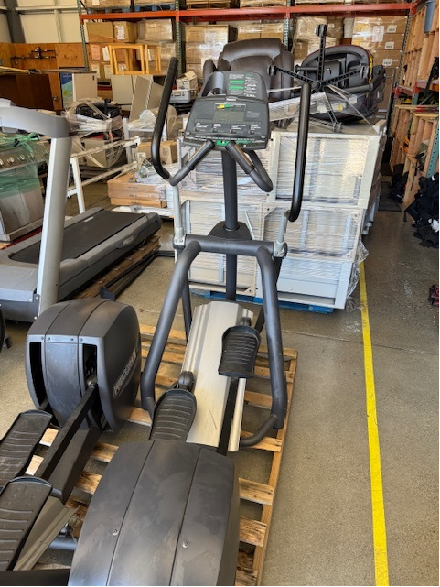
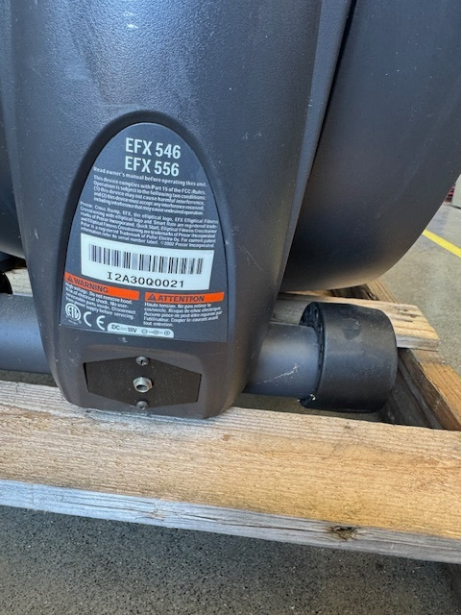
Item # 3 precor efx 556 (Serial # 021)

Slide 6
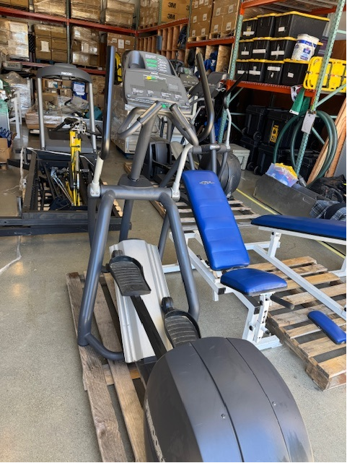
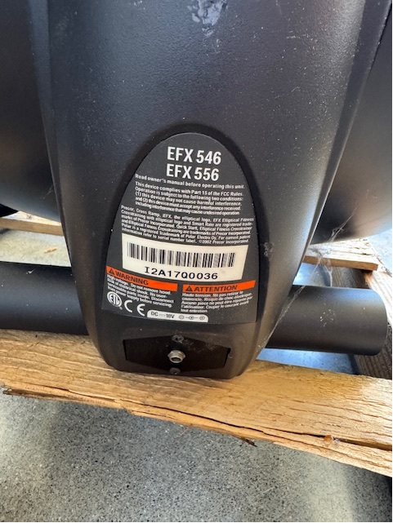
Item # 4 precor efx 556 (Serial # 036)

Slide 7
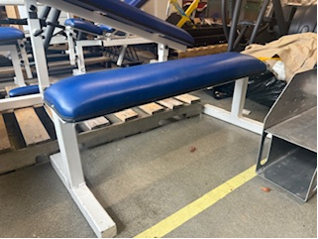
Item # 5
ProMaxima flat weightlifting bench

Slide 8
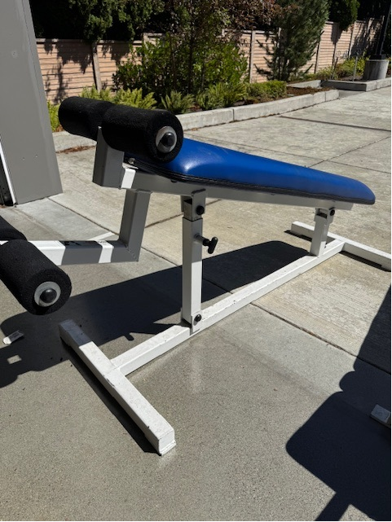
Item # 6
ProMaxima decline weightlifting bench

Slide 9
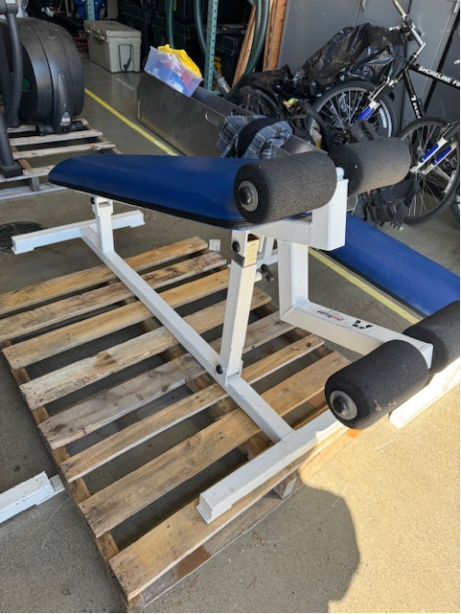
Item # 7
ProMaxima decline weightlifting bench

Slide 10
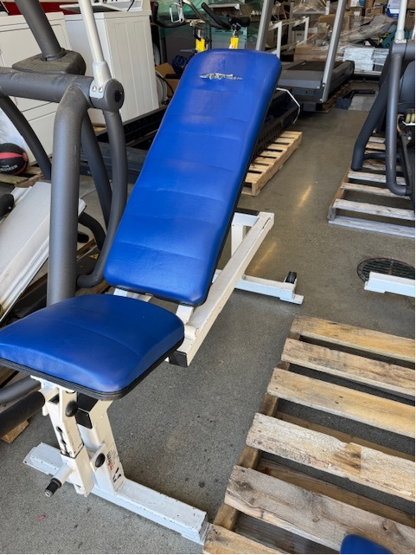
Item # 8
ProMaxima incline weightlifting bench

Slide 11
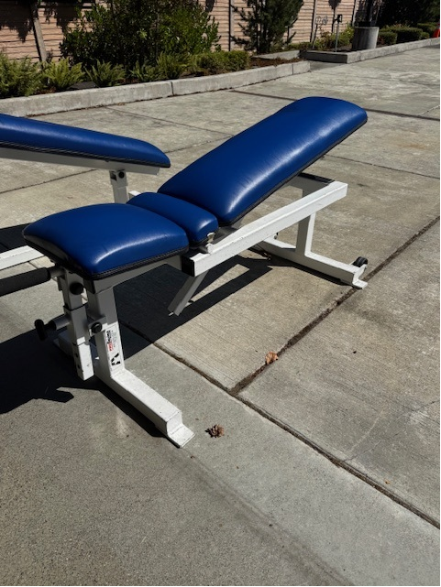
Item # 9
ProMaxima incline weightlifting bench

Slide 12
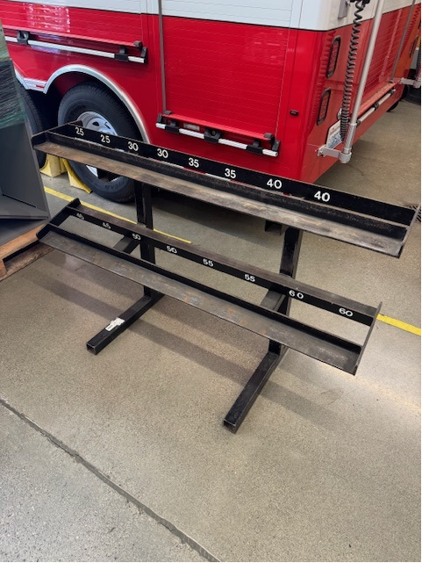
Item # 10
Two Tier Dumbbell storage rack (approximately 50”)

Slide 13
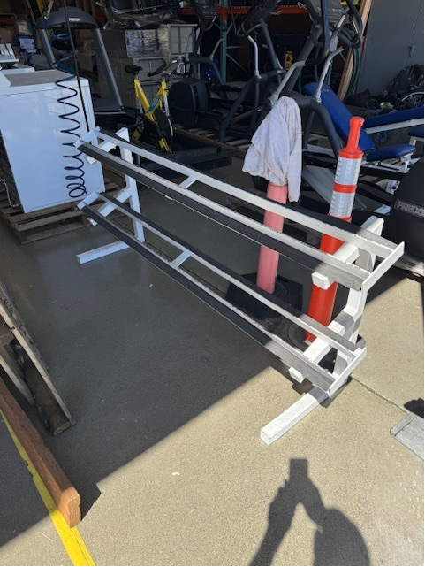
Item # 11
Two Tier Dumbbell storage rack (approximately 84”)

Slide 14
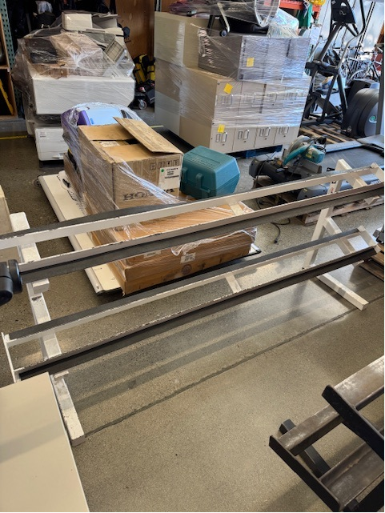
Item # 12
Two Tier Dumbbell storage rack (approximately 84”)

Slide 15
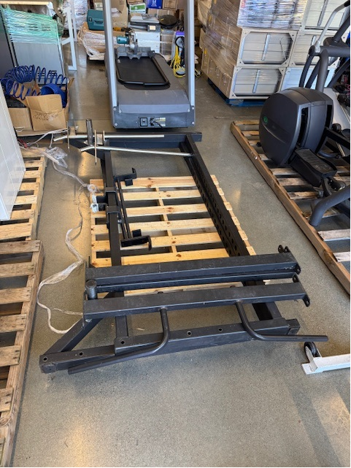
Item # 13
Four Post Squat Rack (unknown brand)

Slide 16
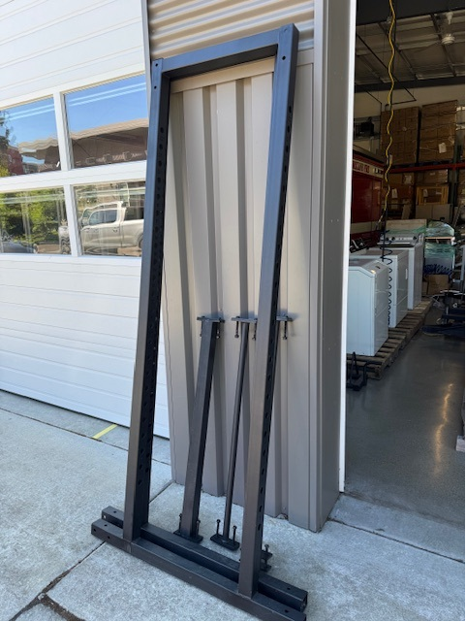
Item # 14
Four Post Squat Rack (unknown brand)

Slide 17
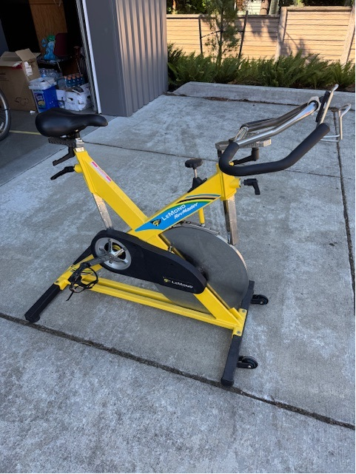
Item # 15
LeMond RevMaster spin bike

Slide 18
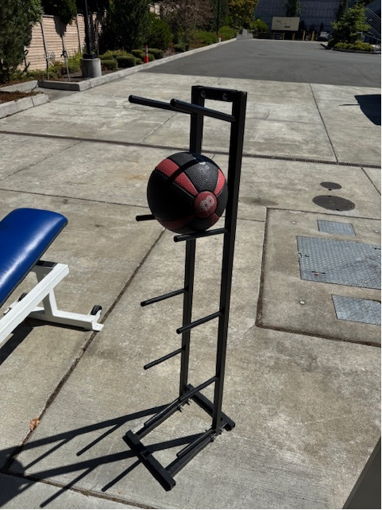
Item # 16
Medicine Ball Storage Rack with a 8 pound Medicine Ball

Slide 19
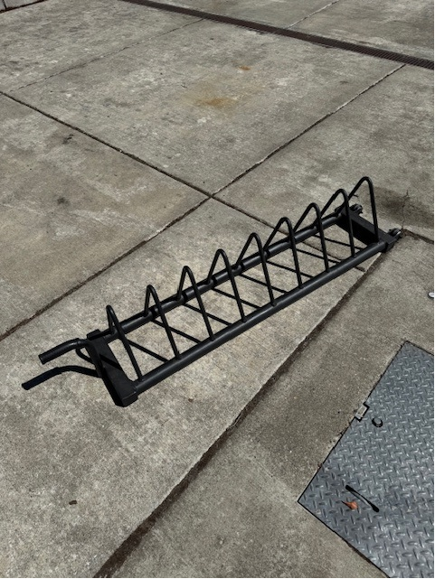
Item # 17
Weight Plate Storage Rack

Slide 20
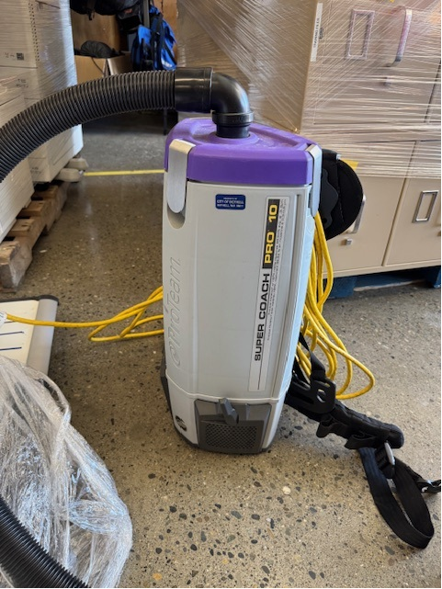
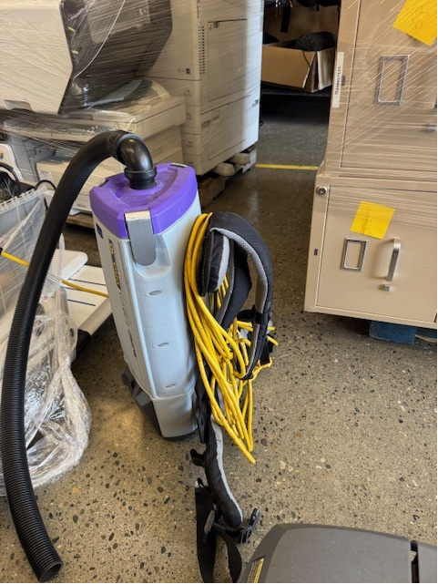
Item # 18 super coach pro 10 backpack vacuum

Slide 21
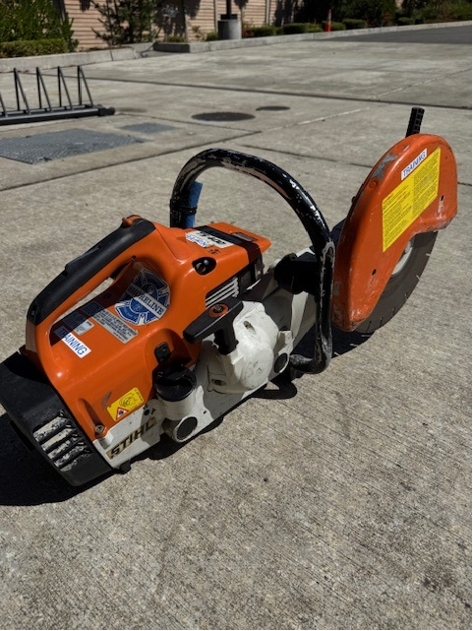
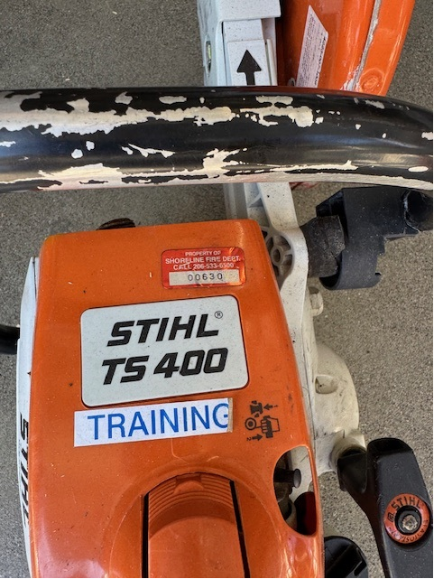
Item # 19 stihl ts400 cut off saw

Slide 22
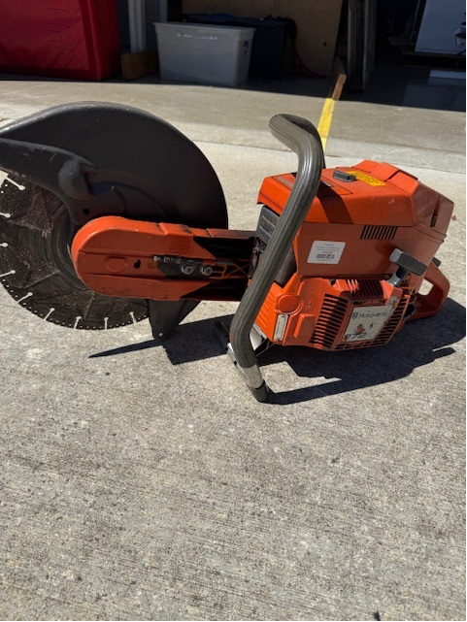
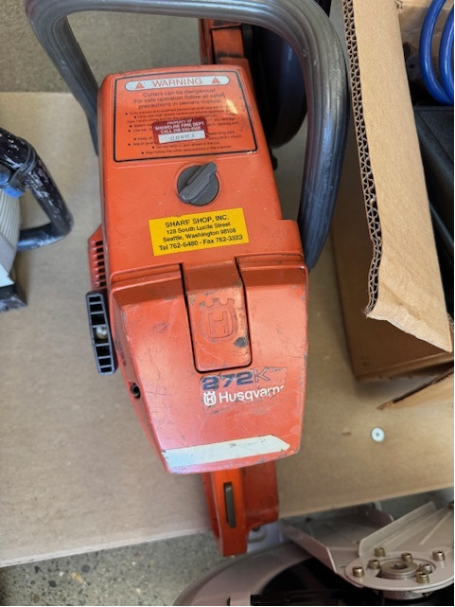
Item # 20
Husqvarna 272k cut off saw

Slide 23
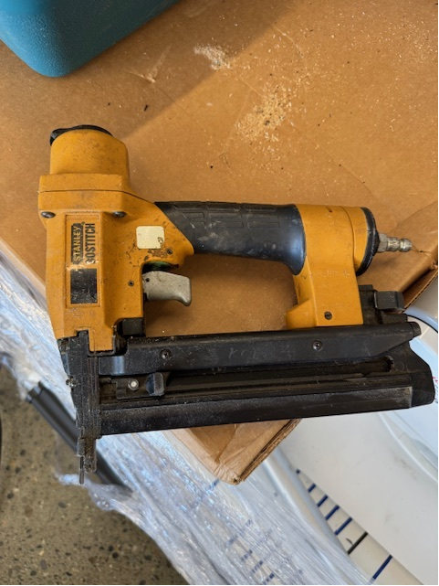
Item # 21
Stanley Bostitch Brad/Finish Nail Gun

Slide 24
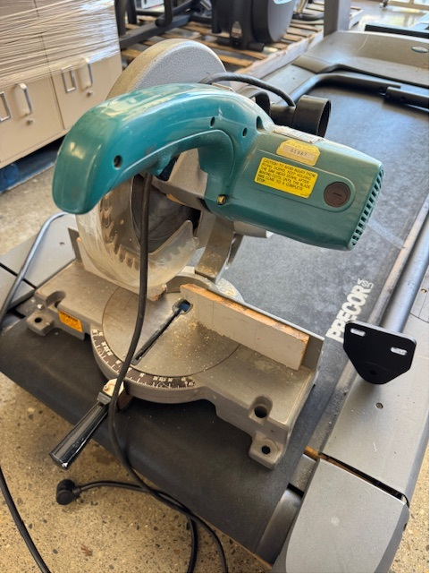
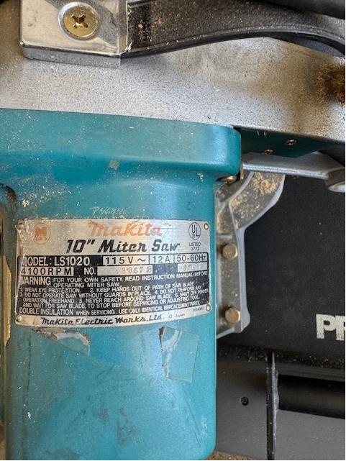
Item # 22
Makita 10” miter saw

Slide 25
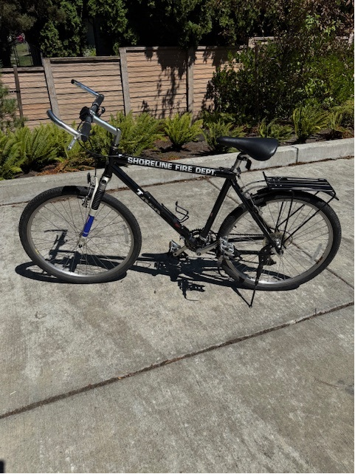
Item # 23
Trek Mountain Bicycle

Slide 26
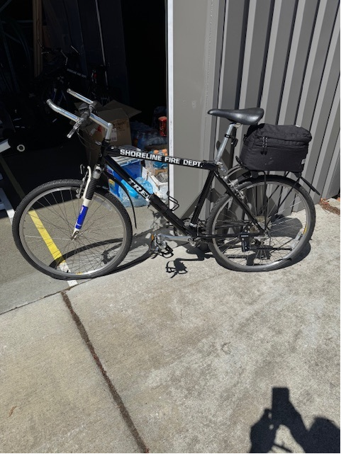
Item # 24
Trek Mountain Bicycle with gear bag

Slide 27
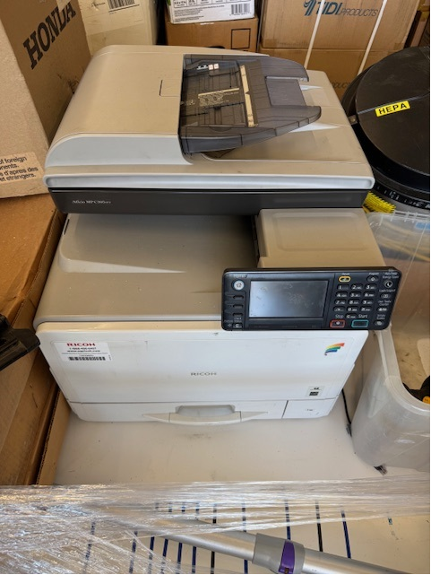
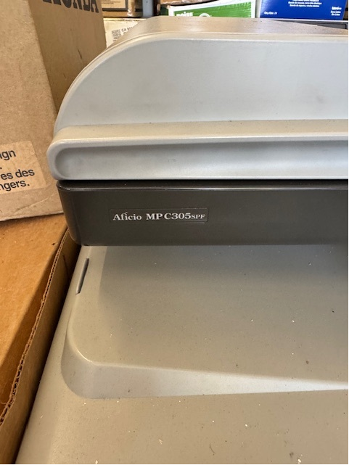
Item # 25 ricoh Aficio mp 305spf printer

Slide 28
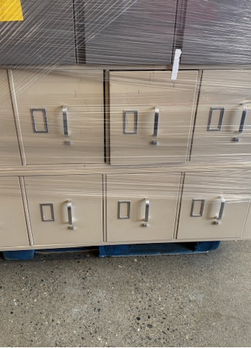
Item # 26
4 Drawer Metal Filing Cabinet

Slide 29
Item # 27
4 Drawer Metal Filing Cabinet

Slide 30
Item # 28
4 Drawer Metal Filing Cabinet

Slide 31
Item # 29
4 Drawer Metal Filing Cabinet

Slide 32
Item # 30
4 Drawer Metal Filing Cabinet

Slide 33
Item # 31
3 Drawer Filing Cabinet

Slide 34
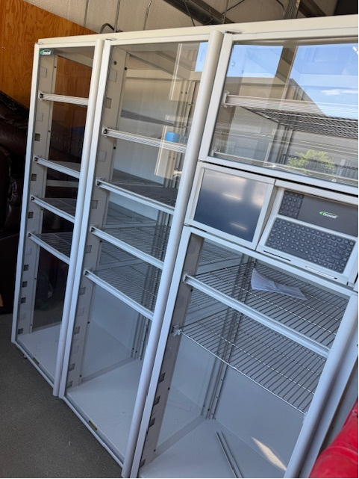
Item # 32
Three Door Storage Cabinet

Slide 35
Rules and instructions for bidders
Item preview will be available by appointment on Thursday September 18 between 10am and 4pm. Email ahansson@shorelinefire.com to schedule appointment
SUBMIT SEALED BIDS Attention DC Matt Hochstein to Station 61, (17525 Aurora Ave N Shoreline, WA 98133) ON OR BEFORE 4pm on Thursday September 18, 2025
Written bid must include bidder’s name, contact information, item # and description of item/items bidding on and bid price for each item
Bidders will be notified by 6pm on Thursday September 18, 2025
Item Pick Up will be Friday September 19, 2025 between 10am and Noon. (Alternate pick up dates can be scheduled for special circumstances)
All sales are final, cash paid in full at time of pick up, no warranties/as is condition and no deliveries.

